Slide 1
FHIR for Executives 1 of 2
Lloyd McKenzie
June 20, 2016

Slide 2
This presentation
Can be downloaded here:
http://gforge.hl7.org/svn/fhir/trunk/presentations/2016-06%20Webinars/FHIR%20for%20Executives1.pptx
Use “anonymous” and email address to logon
Is licensed for use under the Creative Commons, specifically:
Creative Commons Attribution 3.0 Unported License
(Do with it as you wish, so long as you give credit)

Slide 3

Who am I?
Name: Lloyd McKenzie
Company: Gevity
Background:
One of FHIR’s 3 principle editors
Co-chair FMG & FHIR Infrastructure
Co-chair HL7 Modeling & Methodology
Heavily involved in HL7 and healthcare exchange for last 16 years (v2, v3, CDA, etc.)
lmckenzie@gevityinc.com

Slide 4
Tutorial Objectives
You should:
Know where FHIR fits in the broader healthcare landscape, including other HL7 specifications
Be able to explain what FHIR is to others in your organization
Be able to evaluate whether and how FHIR is relevant to your organization and within what timelines
Have a basic picture of what’s happening in the FHIR implementation space right now

Slide 5
Outline
Before break
After break
Why FHIR?
What makes FHIR different?
Core principles
Power of an interface
FHIR Resources
How does FHIR Compare?
FHIR Status
Where is FHIR being used?
Risks & Next steps
Notes:
Toggle

Slide 6
Outline
Monday
Tuesday
Why FHIR?
What makes FHIR different?
Core principles
Power of an interface
FHIR Resources
How does FHIR Compare?
FHIR Status
Where is FHIR being used?
Risks & Next steps
Notes:
Toggle

Slide 7
Attendees
Who is your organization?
What is your role?
HL7 (v2/v3/CDA) background?
How did you hear about FHIR?
How familiar are you with FHIR?
What is the one thing that will make this training most valuable for you?
Notes:
Toggle

Slide 8
WHY FHIR?

Slide 9
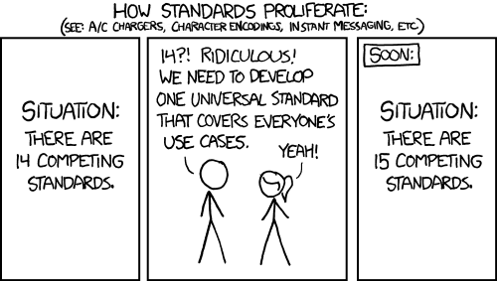
http://xkcd.com/927

Slide 10
Existing healthcare standards and bodies
HL7 – v2, v3, CDA
OpenEHR
CDISC – SDTM, ADAM, define.xml
X12
CTS
ISO – 11179, 21090, etc.
DICOM
W3C – Xforms, XSD
Many others
Do we really need one more?

Slide 11
The Need
Has been a need to share healthcare information electronically for a long time
HL7 v2 is nearly 30 years old
Increasing pressure to broaden scope of sharing
Across organizations, disciplines, even borders
Mobile & cloud-based applications
Faster – integration in days or weeks, not months or years

Slide 12
What we have – v2
Works relatively well within institutions
But
Legacy, custom syntax (learning curve, tools)
Messaging design limits architectures
Doesn’t scale well across organization boundaries
Security/privacy infrastructure is minimal
A potpourri of segments and fields with no means to distinguish the common from edge case

Slide 13
What we have – v3
Newer technology and semi-robust reference model, but
Steep learning curve
Primary implementations by those with $$$$s
No inter-version wire compatibility
International specifications are too abstract, regional implementations don’t interoperate

Slide 14
What we have - CDA
Broad implementation, human-to-human interoperability, but:
Still a very steep learning curve
Interoperability beyond a human-to-human level is still a challenge, even with templates
Document architecture doesn’t fit all problems
Still a diversity of implementations
Extensibility is difficult

Slide 15
Where we’ve gotten
v2, v3 and CDA have produced “bigger” silos
Different IGs / implementations create barriers
Interoperating still requires painful mapping & transformation exercises.
Low discoverability – lots of technical discussions needed before data can flow
Silos are inevitable – differing requirements
But need to lower the barriers and reduce time to build connections between them

Slide 16
So I should drop everything and use FHIR?
Tossing functioning systems the instant a promising newcomer appears is not generally a wise strategy
There’s room for something better
FHIR tries to fill that gap
Market will decide whether FHIR survives, coexists or replaces other products
Effort spent on v2, v3 & CDA can be still be leveraged
Notes:
There are flaws in what exists
There are new use-cases not being met

Slide 17
Problems we face
No central authorities
Permutation of biological and sociological complexity
Fractal use cases
Economics favors balkanization
Externalizing complexity
Much confusion about the problem

Slide 18
Complexity Model
Snomed
HL7 V3
openEHR
WS
CDA
Difficulty (log)
XML
HL7 v2
How?
HTTP / HTML
Text
Semantic Depth

Slide 19
Three Laws of Interoperability
Interoperability: It’s all about the people
You can hide the complexity, or make it worse, but you can’t make it go away
Cheap, flexible, and interoperable: pick two

Slide 20
Platform for Interoperability
Build capability for all systems
Only fix behavior
When everyone agrees to it
When it creates capability or simplicity
Push constraints on behavior to “Implementation Guides”
FHIR is loose, but capable
Implementation space will be fractal ☹

Slide 21
What is FHIR?
And how is it different?

Slide 22
The acronym
F – Fast (to design & to implement)
Relative – No technology can make integration as fast as we’d like
H – Healthcare
That’s why we’re here
I – Interoperable
Ditto
R – Resources
Building blocks – more on these to follow

Slide 23

Genesis of FHIR
What would healthcare exchange look like if we started from scratch using modern approaches?
Web search for success markers led to RESTful based APIs
Exemplar: Highrise (https://github.com/37signals/highrise-api)
Drafted a healthcare exchange API based on this approach

Slide 24
FHIR – Key differences
Focus on Implementers
Target support for common scenarios
Leverage cross-industry web technologies
Require human readability as base level of interoperability
Make content freely available
Support multiple paradigms & architectures
Demonstrate best practice governance
Notes:
We don’t actually have a formal manifesto, but these are the principles we adhere to.

Slide 25
Implementer Focus
Specification is written for one target audience: implementers (that’s not just programmers)
Rationale, modeling approaches, etc. kept elsewhere
Multiple reference implementations from day 1
Publicly available test servers
Starter APIs published with spec
C#, Java, Pascal, Swift, more coming
Connectathons to verify specification approaches
Instances you can read and understand ☺
Lots of examples (and they’re valid too)
using HL7.Fhir.Instance.Model;
using HL7.Fhir.Instance.Parsers;
using HL7.Fhir.Instance.Support;
XmlReader xr = XmlReader.Create(
new StreamRead
IFhirReader r = new XmlFhirReader
// JsonTextReader jr = new JsonTe
// new StreamRead
// IFhirReader r = new JsonFhirRe
ErrorList errors = new ErrorList(
LabReport rep = (LabReport)Resour
Assert.IsTrue(errors.Count() == 0
Notes:
Spec is driven by people who write code
Numerous pieces have been changed because of experience with what worked when trying to implement
Even have a test workbench for RESTful servers

Slide 26
Support “Common” Scenarios
80%
Inclusion of content in core specification is based on “80%” rule
Only include data elements we are confident that most (~80%) of normal implementations using that resource will make use of
Other content in extensions (more on this later)
Easy to say, governance challenge to achieve
Resources are simple and easy to understand & use
Notes:
Design by constraint failed – years to develop, what was produced required yet more design to be implementable and after that might not be interoperable
How to determine the 80%? Look to existing specs – v2, v3, CDA templates, OpenEHR, jurisdictional projects, what implementations we’ve seen
If not sure, err on the side of “not in for now”
Note: not 80% of instances, 80% of implementations
Challenges with “raising the bar”
What happens when there aren’t many/any implementations?

Slide 27
Example – ISO AD type
isNotOrdered, updateMode, flavorId, nullFlavor, controlAct root & extension, validTime low and high, useable period (GTS – no room on the slide), use
home, primary home, vacation home, workplace, direct, public, bad, physical, postal, temporary, alphabetic, ideographic, syllabic, search, soundex, phonetic
0..* parts, each with:
value, code, code system, code system name, code system version, language, type:
address line, additional locator, unit identifier, unit designator, delivery address line, delivery installation type, delivery installation area, delivery installation qualifier, delivery mode, delivery mode identifier, street address line, building number, building number numeric, building number suffix, street name, street name base, street type, direction, intersection, care of, census tract, country, county or parish, municipality, delimiter, post box, precinct, state or province, postal code, delivery point identifier
Notes:
How many of your systems have user interfaces that support even ¼ of this?

Slide 28
Example – FHIR Address
isNotOrdered, updateMode, flavorId, nullFlavor, controlAct root & extension, validTime low and high, useable period (low, high) (GTS – no room on the slide), use
home, primary home, vacation home, workplace, direct, public, bad, physicalvisit, postal, temporary, alphabetic, ideographic, syllabic, search, soundex, phonetic, old
0..* parts, each with:text
value, code, code system, code system name, code system version, language, type:
address line, additional locator, unit identifier, unit designator, delivery address line, delivery installation type, delivery installation area, delivery installation qualifier, delivery mode, delivery mode identifier, street address line, building number, building number numeric, building number suffix, street name, street name base, street type, direction, intersection, care of, census tract, country, county or parish, municipalitycity, delimiter, post box, precinct, state or province, postalCode, delivery point identifier
Notes:
This is what happens when you apply the 80% . . .

Slide 29
Won’t extensions break interoperability?
The 80% + narrative helps provide “base” interoperability
For “robust” interoperability
Profile – constrains structure
Conformance – constrains behavior
Needed to claim “I’m FHIR conformant”
Notes:
1000s of extensions, everyone supports different things, don’t know what anyone does
Not everyone will support the 80%, but most will
“What most systems support” (and thus what you should probably support too) encourages base interoperability
Human readable fallback
Profile – what elements are supported, registries available
Conformance – REST operations, documents, messages, services

Slide 30
Web technologies
Instances shared using XML & JSON
Web calls work the same way they do for Google & Twitter
Rely on HTTPS, OAuth, etc. for security functions
Benefits
Cross-Industry standards
Well supported by tools
Understood by developers
http://...
Notes:
We try very hard to *not* invent stuff that exists elsewhere unless it’s really broken or totally unaligned with the FHIR principles.

Slide 31

Human Readable
Clinical Documents has both narrative and data
The data / narrative dynamic exists throughout the process
In FHIR, every resource can (should) have a human-readable expression
Can be direct rendering or human entered
Notes:
Even when you think your target will understand all the encoded data, reality is data often gets shared beyond the originally intended context
Allow for exceptions for things like automated device readings, etc.

Slide 32
Freely available
Unencumbered – free for use, no membership required
http://hl7.org/fhir + other versions
Licensed under CC0: True public domain
Any use is allowed
HL7 enforces the trademark protection
Business model:
If you want to vote, you need to pay
Notes:
Was a bigger deal before HL7 decided to open up all IP
Link to full legal text towards bottom of FHIR home page

Slide 33
Paradigms
FHIR supports 4 interoperability paradigms
REST – Lightweight, leverages web stack
Documents – Long-term persistence
Messages – Request/response paradigm
Services – other SOA-based interfaces
Regardless of approach, content stays the same
Can leverage same models, same profiles everywhere

Slide 34
Review
What are FHIR’s 7 “Key Differences”

Slide 35

Architectures
FHIR makes no assumptions about the architectural design of systems
Notes:
Light or heavy clients
Central server or peer-to-peer sharing
Push or pull
Query or publish/subscribe
Loosely coupled or tightly coupled environments
With history tracking or without

Slide 36
FHIR & Cost of Integration
These factors will drive down the cost of integration and interoperability
Easier to Develop
Easier to Troubleshoot
Easier to Leverage in production
More people to do the work (less expensive consultants)
Competing approaches will have to match the cost, or disappear – effect is already being felt

Slide 37
Future impact of FHIR
Impact of FHIR on the market:
Drive interoperability prices down
Higher Expectations
Increased spend on integration (N x 2!)
Overall Market focus
PHR on the web
Healthcare repositories (MHD+)
Device Data management
Freeing data can enable new business models and new companies
Notes:
How much integration do you need? Nx2 – twice what you have

Slide 38
FHIR Resources

Slide 39
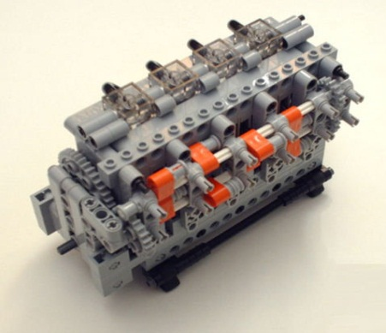
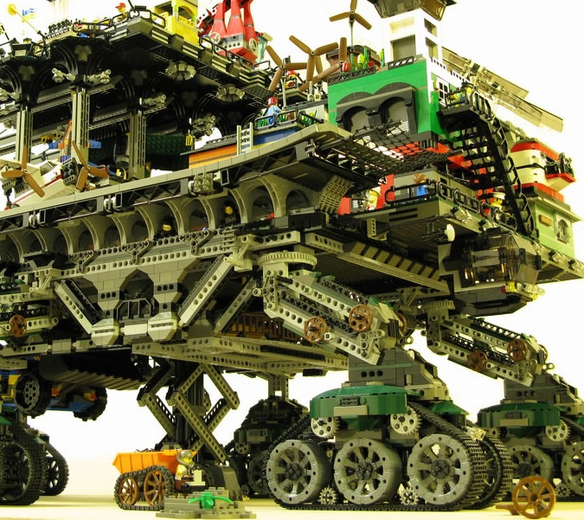

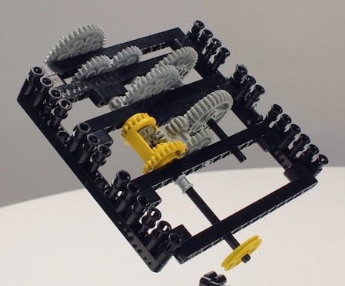
FHIR solutions
Resources
Extensions
Solution
+
=
Notes:
Resources are building blocks, but useful in their own right
Extensions supplement what resource doesn’t cover
Solutions can be simple or complex

Slide 40

Resources
“Resources” are:
Small logically discrete units of exchange
Defined behavior and meaning
Known identity / location
Smallest unit of transaction
“of interest” to healthcare
V2: Sort of like Segments
V3: Sort of like CMETs

Slide 41
FHIR Resource URLs
Template | Description | Example | Operations
[base] | Server URL | http://fhir.com | OPTIONS, POST
[base]/[type] | Collection Manager | http://fhir.com/Patient | GET, POST
[base]/[type]/[id] | URL for a resource | http://fhir.com/Patient /23 | GET, PUT, DELETE
[base]/[type]/[id]/$[name] | Operation (server action) | http://fhir.com/Patient /23/$everything | POST
[base]/[type]/[id]/_history/[vid] | Past version | http://fhir.com/Patient/23/_history/2 | GET

Slide 42
What’s a Resource?
Examples
Non-examples
Administrative
Patient, Practitioner, Organization, Location, Coverage, Invoice
Clinical Concepts
Allergy, Condition, Family History, Care Plan
Infrastructure
Document, Message, Profile, Conformance
Gender
Too small
Electronic Health Record
Too big
Blood Pressure
Too specific
Intervention
Too broad
100-150 total - ever
Notes:
And few systems will ever see more than 40-50

Slide 43
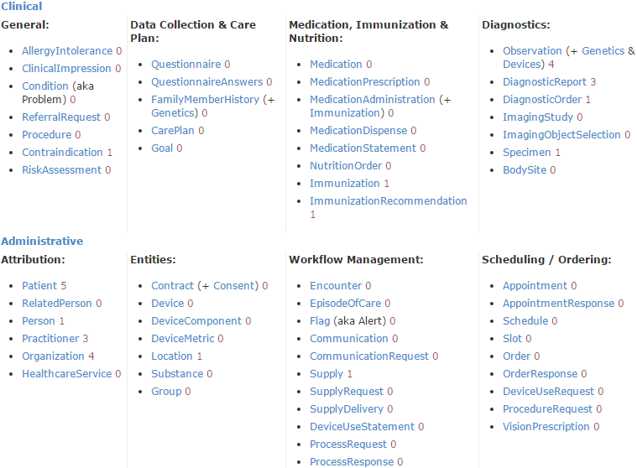
STU 2 Resource List

Slide 44
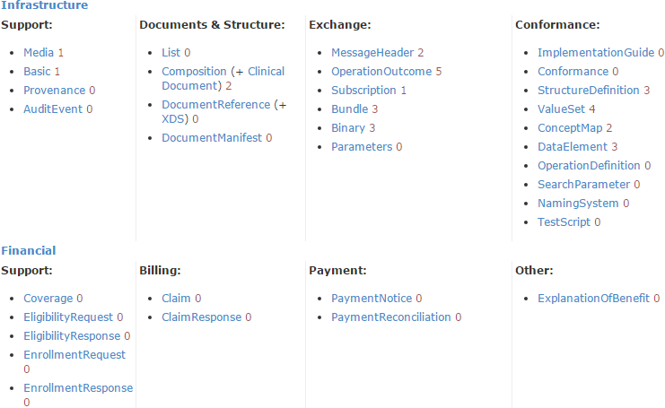
STU 2 Resource List

Slide 45
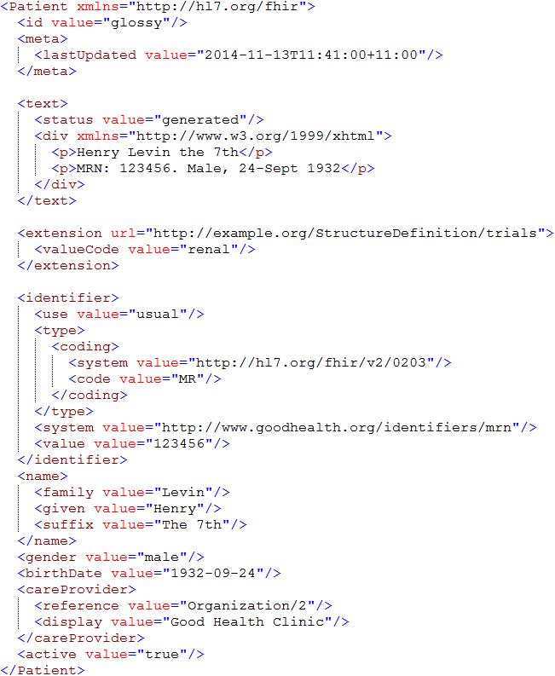
Identity & Metadata
Human Readable Summary
Extension with reference to its definition
Standard Data Content:
MRN
Name
Gender
Date of Birth
Provider

Slide 46
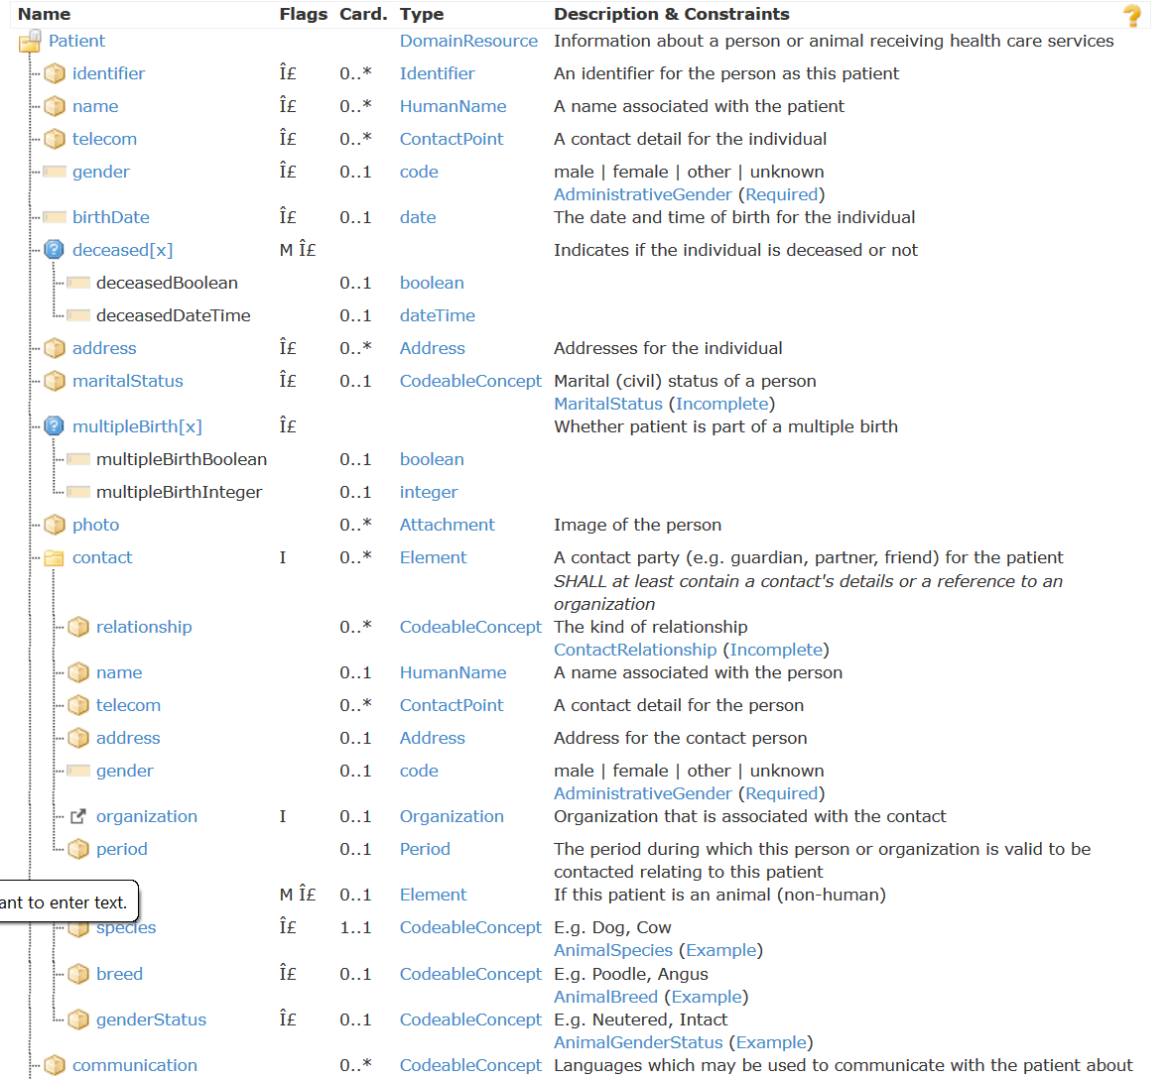
Resource Definitions

Slide 47
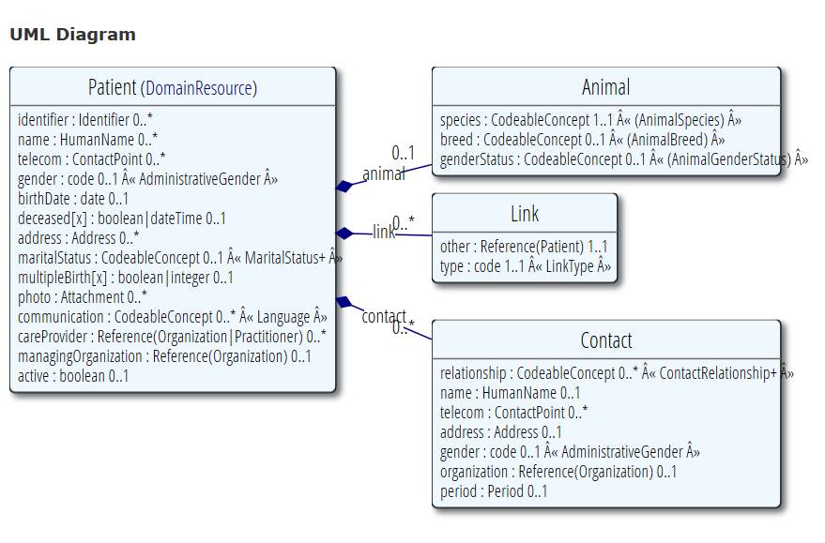
Resource Definitions

Slide 48
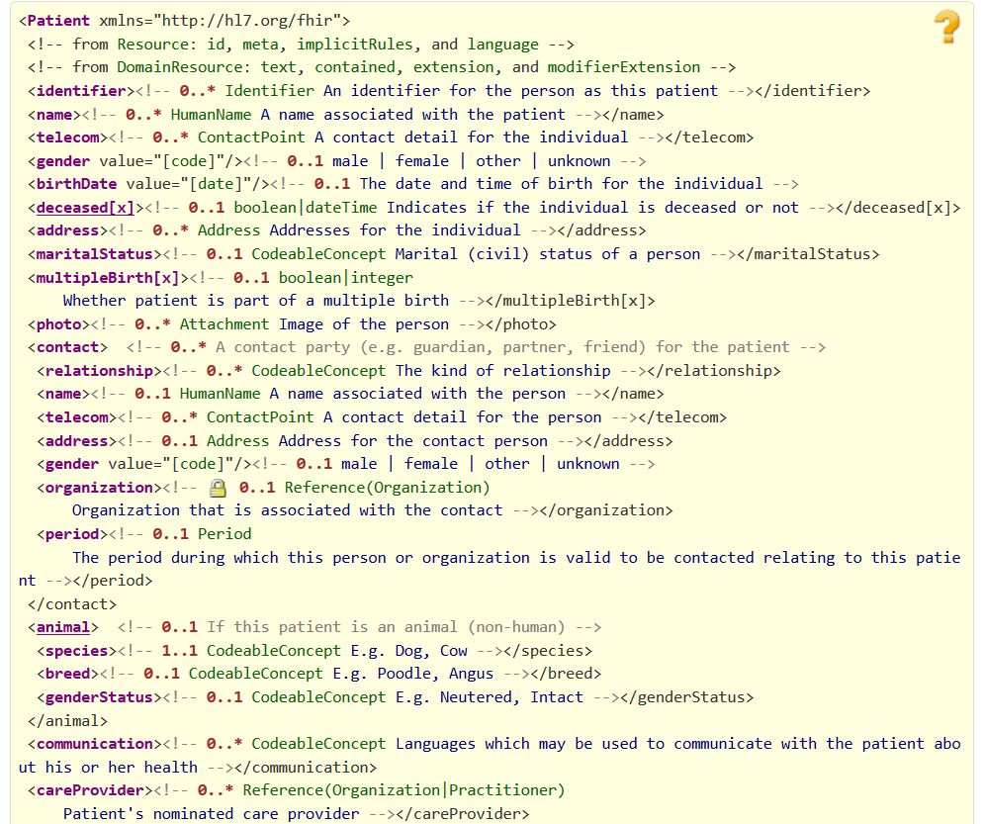
Resource Definitions

Slide 49
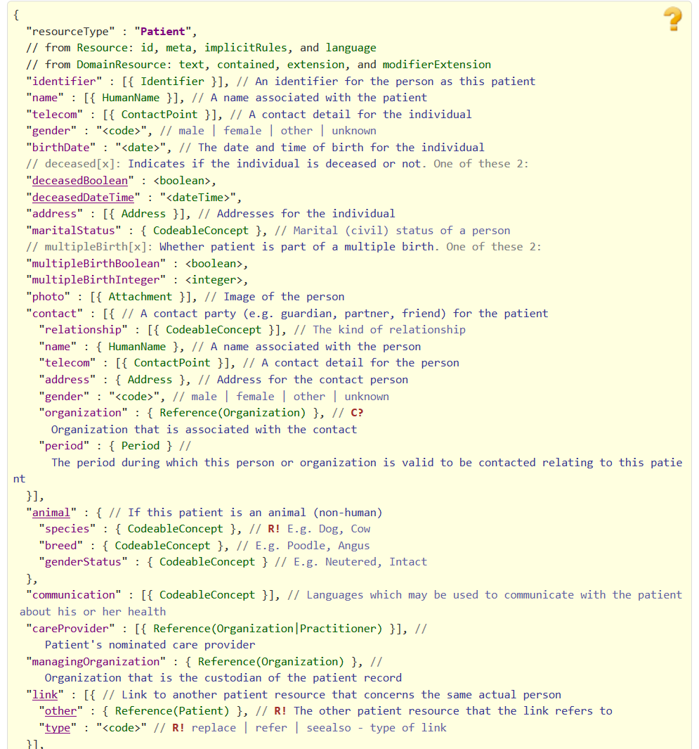
Resource Definitions

Slide 50
Why resources?
Increases re-use
Can use the same resource structures (and profiles on them) in many solutions
Lighter-weight communication
Can point to resources “by reference” rather than sending all data
Aligns well with how data is stored

Slide 51
What’s in a resource definition?
Each resource defines:
What elements are part of “core”
Names
Definitions
Cardinality
Code lists
Mappings (to RIM, v2 and other specs)
Constraints
All in a computable form
Create spec, schemas, reference implementations

Slide 52
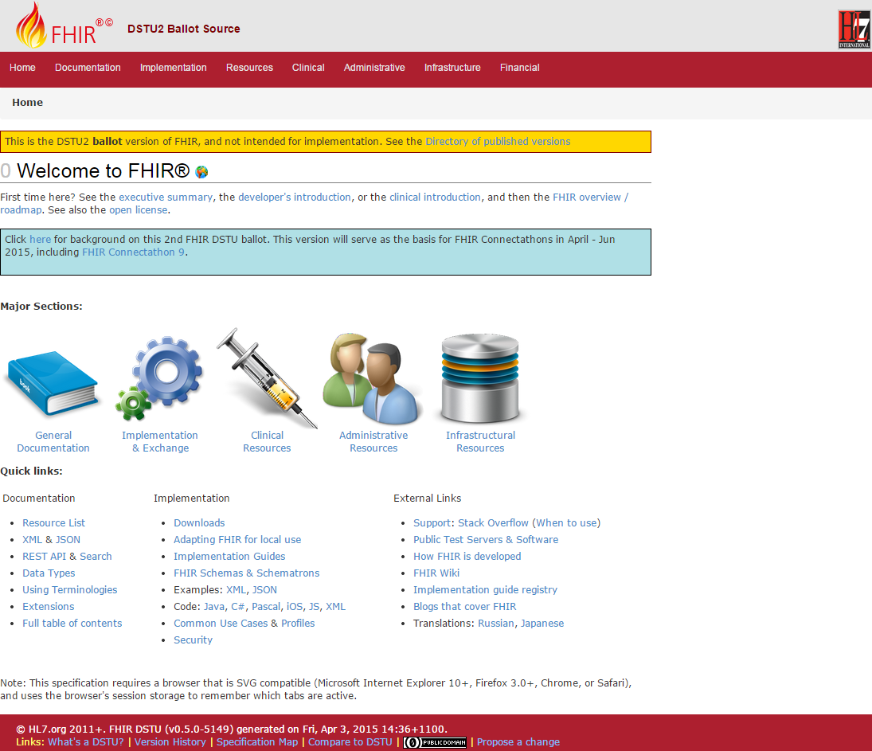
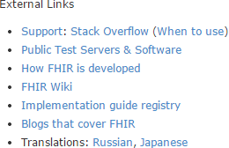
(FHIR home)
hl7.org/fhir
Notes:
Published as HTML
Published using validation process that performs consistency checks – like a software build
Really shouldn’t require much guidance to read, but a few things to call out
Objective of spec is developer can skim and decide in < day

Slide 53
Outline
Before break
After break
Why FHIR?
What makes FHIR different?
Core principles
Power of an interface
FHIR Resources
How does FHIR Compare?
FHIR Status
Where is FHIR being used?
Risks & Next steps
Notes:
Toggle

Slide 54
Outline
Monday
Tuesday
Why FHIR?
What makes FHIR different?
Core principles
Power of an interface
FHIR Resources
How does FHIR Compare?
FHIR Status
Where is FHIR being used?
Risks & Next steps
Notes:
Toggle

Slide 55
Break!
Notes:
Toggle

Slide 56

Questions?
http://hl7.org/fhir lmckenzie@gevityinc.com

